Slide 1

HTML DOM
May 2012

Slide 2
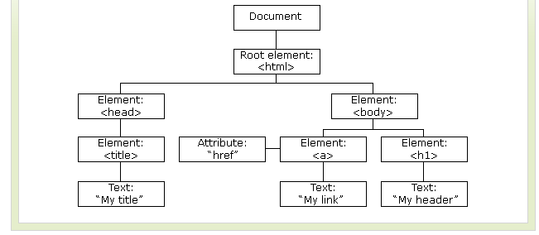
HTML DOM
The HTML DOM defines a standard way for accessing and manipulating HTML documents.
The DOM presents an HTML document as a tree-structure.

Slide 3
HTML DOM
The DOM is a W3C (World Wide Web Consortium) standard.
The DOM defines a standard for accessing documents like HTML and XML:
"The W3C Document Object Model (DOM) is a platform and language-neutral interface that allows programs and scripts to dynamically access and update the content, structure, and style of a document."
The DOM defines the objects and properties of all document elements, and the methods (interface) to access them.
The HTML DOM is:
A standard object model for HTML
A standard programming interface for HTML
Platform- and language-independent
A W3C standard
The HTML DOM defines the objects and properties of all HTML elements, and the methods (interface) to access them.
In other words: The HTML DOM is a standard for how to get, change, add, or delete HTML elements.

Slide 4
HTML DOM Nodes
DOM Nodes
According to the DOM, everything in an HTML document is a node.
The DOM says:
The entire document is a document node
Every HTML element is an element node
The text in the HTML elements are text nodes
Every HTML attribute is an attribute node
Comments are comment nodes

Slide 5
HTML DOM Nodes
<html> <head> <title>DOM Tutorial</title> </head> <body> <h1>DOM Lesson one</h1> <p>Hello world!</p> </body> < /html>
// The root node in the HTML above is <html>. All other nodes in the document are contained within <html>.
//The <html> node has two child nodes; <head> and <body>.
//The <head> node holds a <title> node. The <body> node holds a <h1> and <p> node.
//<title>DOM Tutorial</title>, the element node < title>, holds a text node with the value "DOM Tutorial".
//"DOM Tutorial" is not the value of the <title> element!
//However, in the HTML DOM the value of the text node can be accessed by the innerHTML property.

Slide 6
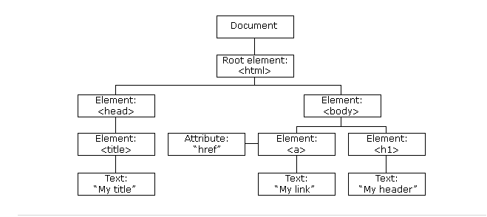
HTML DOM Nodes
The HTML DOM views an HTML document as a tree-structure. The tree structure is called a node-tree.
All nodes can be accessed through the tree. Their contents can be modified or deleted, and new elements can be created.
The node tree below shows the set of nodes, and the connections between them. The tree starts at the root node and branches out to the text nodes at the lowest level of the tree:

Slide 7
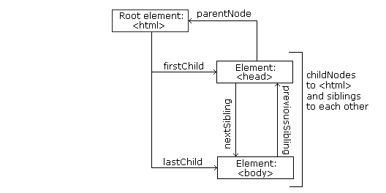
HTML DOM Nodes
Node Parents, Children, and Siblings
The nodes in the node tree have a hierarchical relationship to each other.
The terms parent, child, and sibling are used to describe the relationships. Parent nodes have children. Children on the same level are called siblings (brothers or sisters).
In a node tree, the top node is called the root
Every node, except the root, has exactly one parent node
A node can have any number of children
A leaf is a node with no children
Siblings are nodes with the same parent
The following image illustrates a part of the node tree and the relationship between the nodes:

Slide 8
HTML DOM Nodes
<html> <head> <title>DOM Tutorial</title> </head> <body> <h1>DOM Lesson one</h1> <p>Hello world!</p> </body> < /html>
The <html> node has no parent node; it is the root node
The parent node of the <head> and <body> nodes is the <html> node
The parent node of the "Hello world!" text node is the <p> node
and:
The <html> node has two child nodes; <head> and <body>
The <head> node has one child node; the <title> node
The <title> node also has one child node; the text node "DOM Tutorial"
The <h1> and <p> nodes are siblings, and both child nodes of <body>

Slide 9
HTML DOM Nodes
The lines between the <script> and </script> contain the JavaScript and are executed by the browser.
In this case the browser will replace the content of the HTML element with id="demo", with the current date:
<html> < body> < h1>My First Web Page</h1> < p id="demo">This is a paragraph.</p> <script type="text/javascript"> document.getElementById("demo").innerHTML=Date(); < /script> </body> < /html>

Slide 10
HTML DOM Properties and Methods
In the DOM, HTML documents consist of a set of node objects. The nodes can be accessed with JavaScript or other programming languages. In this tutorial we will use JavaScript.
The programming interface of the DOM is defined by standard properties and methods.
Properties are often referred to as something that is (i.e. the name of a node).
Methods are often referred to as something that is done (i.e. remove a node).
HTML DOM Properties
Some DOM properties:
x.innerHTML - the text value of x
x.nodeName - the name of x
x.nodeValue - the value of x
x.parentNode - the parent node of x
x.childNodes - the child nodes of x
x.attributes - the attributes nodes of x

Slide 11
HTML DOM Properties and Methods
HTML DOM Methods
x.getElementById(id) - get the element with a specified id
x.getElementsByTagName(name) - get all elements with a specified tag name
x.appendChild(node) - insert a child node to x
x.removeChild(node) - remove a child node from x
The innerHTML Property
The easiest way to get or modify the content of an element is by using the innerHTML property.
innerHTML is not a part of the W3C DOM specification. However, it is supported by all major browsers.
The innerHTML property is useful for returning or replacing the content of HTML elements (including <html> and <body>), it can also be used to view the source of a page that has been dynamically modified.

Slide 12
HTML DOM Properties and Methods
<html> < body> < p id="intro">Hello World!</p> < script type="text/javascript"> txt=document.getElementById("intro").innerHTML; document.write("<p>The text from the intro paragraph: " + txt + "</p>"); < /script> < /body> < /html>

Slide 13
HTML DOM Properties and Methods
childNodes and nodeValue
We can also use the childNodes and nodeValue properties to get the content of an element.
The following code gets the value of the <p> element with id="intro":
<html> < body> < p id="intro">Hello World!</p> < script type="text/javascript"> txt=document.getElementById("intro").childNodes[0].nodeValue; document.write("<p>The text from the intro paragraph: " + txt + "</p>"); < /script> < /body> < /html>

Slide 14
HTML DOM Access Nodes
Accessing Nodes
You can access a node in three ways:
By using the getElementById() method
By using the getElementsByTagName() method
By navigating the node tree, using the node relationships
The getElementById() Method
The getElementById() method returns the element with the specified ID:
The getElementsByTagName() Method
getElementsByTagName() returns all elements with a specified tag name.
document.getElementById("intro");
document.getElementsByTagName("p");
document.getElementById("main").getElementsByTagName("p");

Slide 15
HTML DOM Access Nodes
DOM Node List
The getElementsByTagName() method returns a node-list. A node-list is an array of nodes.
The following code selects all <p> nodes in a node-list:
DOM Node List Length
The length property defines the number of nodes in a node-list.
You can loop through a node-list by using the length property:
x=document.getElementsByTagName("p");
y=x[1];
x=document.getElementsByTagName("p"); for (i=0;i<x.length;i++) { document.write(x[i].innerHTML); document.write("<br />"); }

Slide 16
HTML DOM Access Nodes
Navigating Node Relationships
The three properties; parentNode, firstChild, and lastChild, follow the document structure and allow short-distance travel in a document.
Look at the following HTML fragment:
<html> < body> <p id="intro">Hello World!</p>
<script type="text/javascript"> x=document.getElementById("intro"); document.write(x.firstChild.nodeValue); < /script> < div> < p>The DOM is very useful!</p> < p>This example demonstrates node relationships.</p> < /div> < /body> < /html>

Slide 17
HTML DOM Node Information
Node Properties
In the HTML DOM, each node is an object.
Objects have methods and properties that can be accessed and manipulated by JavaScript.
Three important node properties are:
nodeName
nodeValue
nodeType
The nodeName Property
The nodeName property specifies the name of a node.
nodeName is read-only
nodeName of an element node is the same as the tag name
nodeName of an attribute node is the attribute name
nodeName of a text node is always #text
nodeName of the document node is always #document

Slide 18
HTML DOM Node Information
The nodeValue Property
The nodeValue property specifies the value of a node.
nodeValue for element nodes is undefined
nodeValue for text nodes is the text itself
nodeValue for attribute nodes is the attribute value
<html> < body> < p id="intro">Hello World!</p> < script type="text/javascript"> x=document.getElementById("intro"); document.write(x.firstChild.nodeValue); < /script> < /body> < /html>

Slide 19
HTML DOM - Change HTML Elements
Change an HTML Element
HTML DOM and JavaScript can change the inner content and attributes of HTML elements.
The following example changes the background color of the <body> element:
<html> < body> < script type="text/javascript"> document.body.bgColor="lavender"; < /script> < /body> < /html>

Slide 20
HTML DOM – Change HTML Elements
Change the Text of an HTML Element - innerHTML
The easiest way to get or modify the content of an element is by using the innerHTML property.
The following example changes the text of a <p> element:
<html> < body> < p id="p1">Hello World!</p> < script type="text/javascript"> document.getElementById("p1").innerHTML="New text!"; < /script> < /body> < /html>

Slide 21
HTML DOM – Change HTML Elements
An event handler allows you to execute code when an event occurs.
Events are generated by the browser when the user clicks an element, when the page loads, when a form is submitted, etc.
You can read more about events in the next chapter.
The following example changes the background color of the <body> element when a button is clicked:
<html> < body> < input type="button" onclick="document.body.bgColor='lavender';" value="Change background color" /> < /body> < /html>

Slide 22
HTML DOM – Change HTML Elements
Change the Text of an Element - with a Function
The following example uses a function to change the text of the <p> element when a button is clicked:
<html> < head> < script type="text/javascript"> function ChangeText() { document.getElementById("p1").innerHTML="New text!"; } < /script> < /head> < body> < p id="p1">Hello world!</p> < input type="button" onclick="ChangeText()" value="Change text" /> < /body> < /html>

Slide 23
HTML DOM – Change HTML Elements
Using the Style Object
The Style object of each HTML element represents its individual style.
The following example uses a function to change the style of the <body> element when a button is clicked:
<html> < head> < script type="text/javascript"> function ChangeBackground() { document.body.style.backgroundColor="lavender"; } < /script> < /head> < body> < input type="button" onclick="ChangeBackground()" value="Change background color" /> < /body> < /html>

Slide 24
HTML DOM – Change HTML Elements
Change the font and color of an Element
The following example uses a function to change the style of the <p> element when a button is clicked:
<html> < head> < script type="text/javascript"> function ChangeStyle() { document.getElementById("p1").style.color="blue"; document.getElementById("p1").style.fontFamily="Arial"; } < /script> < /head> < body> < p id="p1">Hello world!</p> < input type="button" onclick="ChangeStyle()" value="Change style" /> < /body> < /html>

Slide 25
THANK YOU

